Slide 1
Enhancing Trust in the Cryptocurrency Marketplace: A Risk Scoring Approach
Sudip Bhattacharyya, Dan Freeman, Timothy McWilliams, Craig Hall and Pablo Peillard
July 13, 2018

Slide 2
Cryptocurrency: An Overview
Cryptocurrency is a digital asset used as a medium of exchange enabled by a cryptographic encryption-decryption mechanism to secure transactions, control creation of additional units and verify transfer of assets.

Slide 3
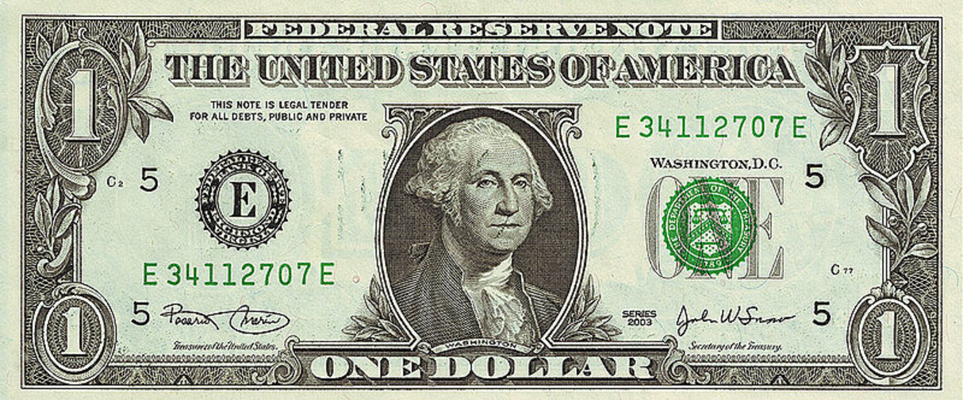

Conventional Currency vs Cryptocurrency
Conventional Currency
Cryptocurrency
Physical currency exists
A centralized authority in control
Intermediaries take part in case of disputes
Users' identity visible
Transactions can be reversed or corrected if required
No existence of physical currency
No centralized authority in control
No intermediary required
Offers complete anonymity for users
Transactions are immutable or irreversible

Slide 4




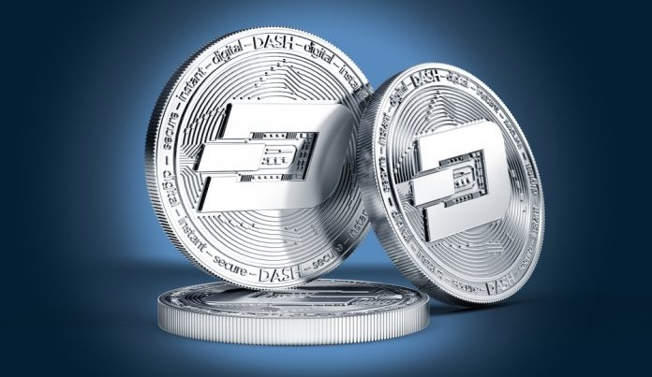
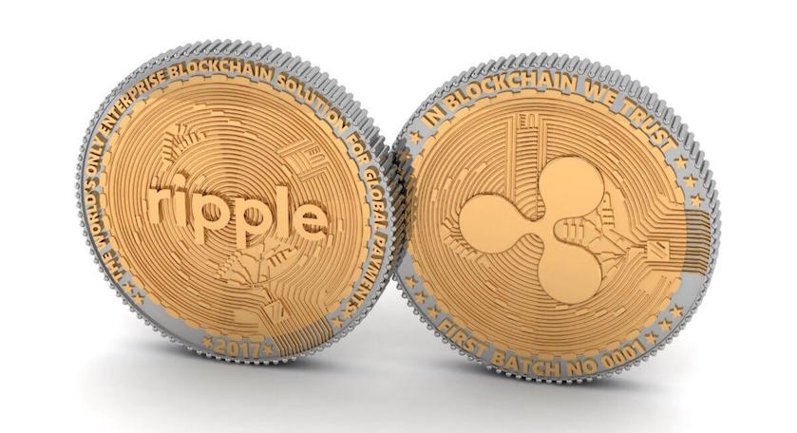

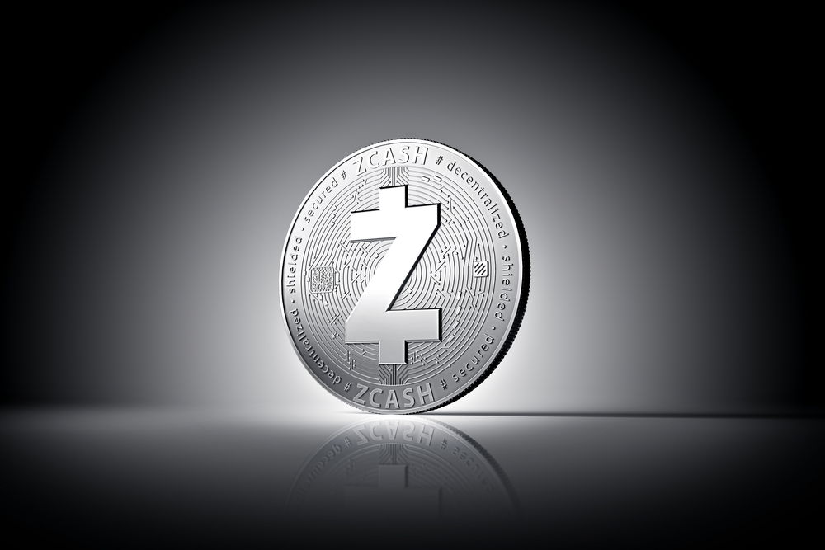
Popular Cryptocurrencies
Bitcoin
Litecoin
Ethereum
Monero
Dash
Ripple
Neo
Zcash

Slide 5
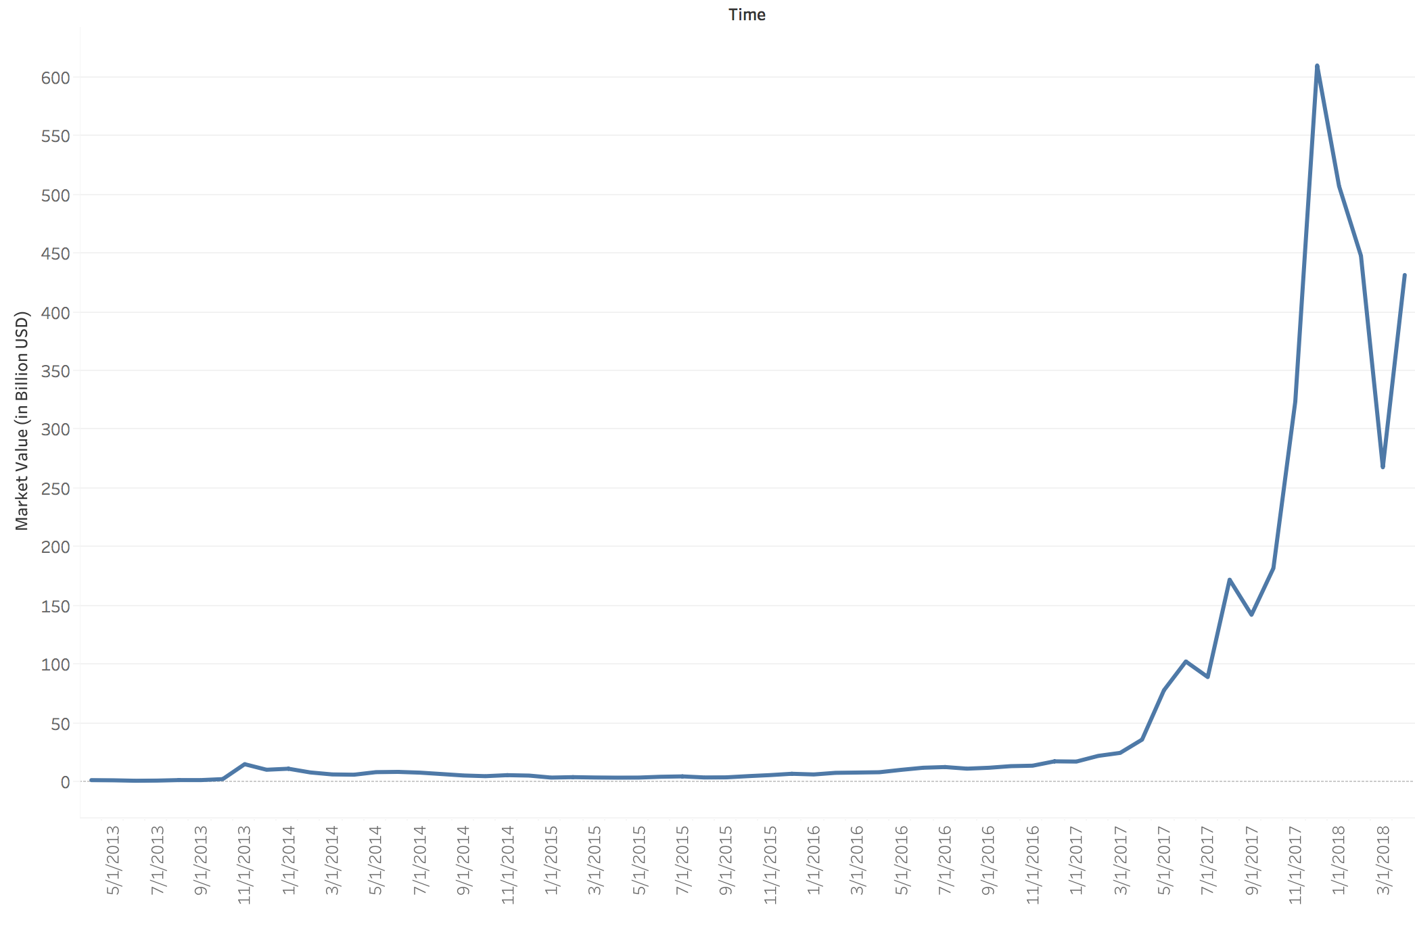
Cryptocurrency: Market Capitalization
Total cryptocurrency market valued at over $400 billion as of April 2018
Market capitalization reached peak at $600 billion in January 2018

Slide 6
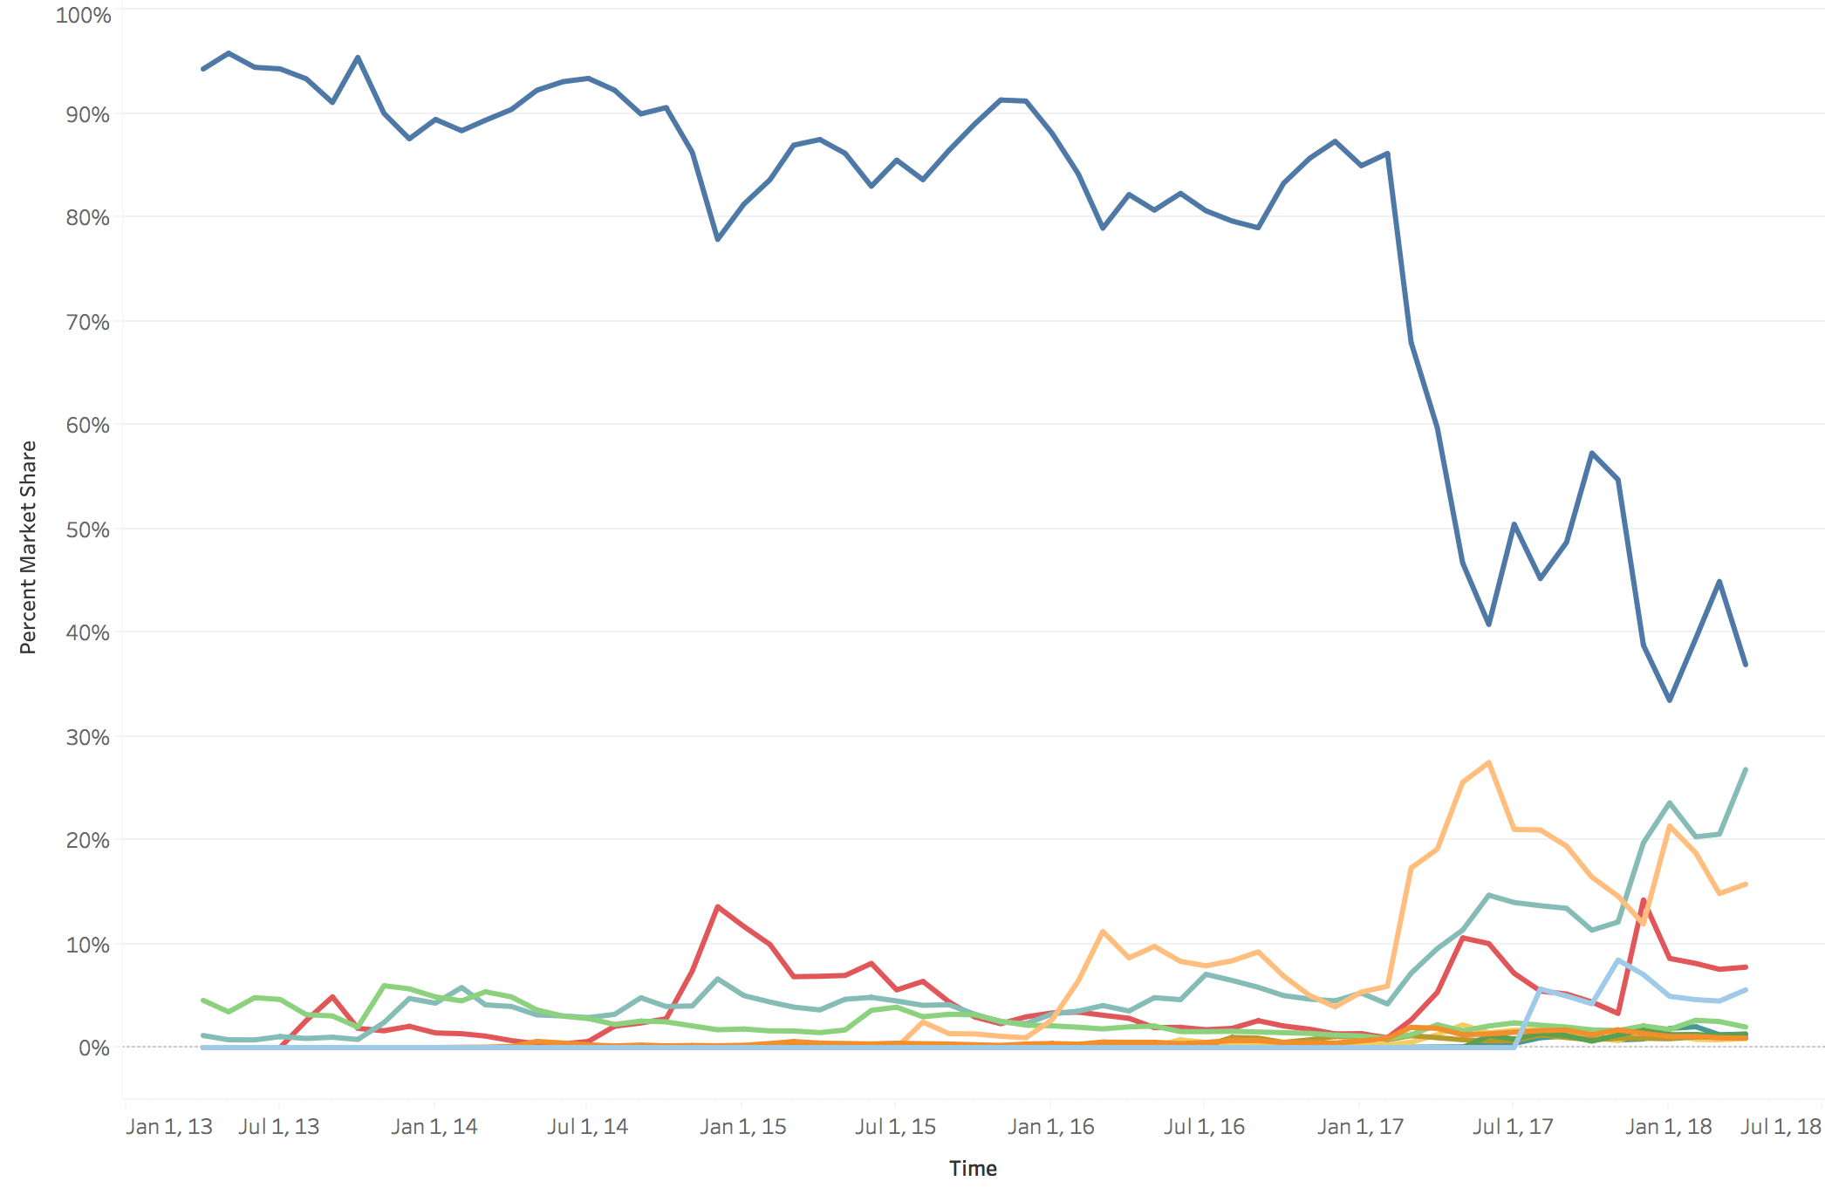
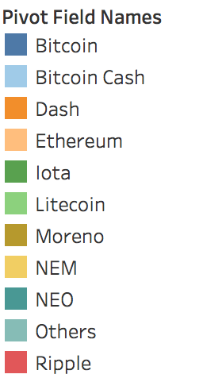
Cryptocurrency: Market Share
Bitcoin dominated market with >80% market share until end of 2016
As of Q1 2018, Bitcoin enjoys maximum share (~37%)
Ethereum 16%, Ripple 8%, Bitcoin Cash 6% market share in Q1 2018

Slide 7
Blockchain: A Cryptocurrency Network
Introduced by Satoshi Nakamoto in 2009
Platform to run Bitcoin and other cryptocurrency networks
Blockchain
Peer-to-peer distributed ledger system,
no centralized control
Trust built on cryptographic proof, no existence of intermediaries

Slide 8
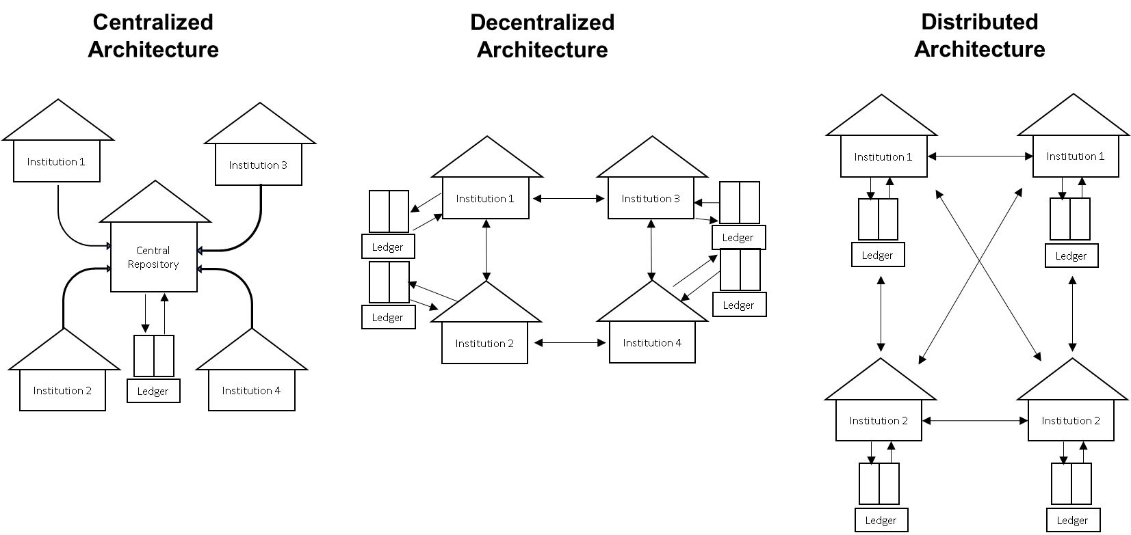
The Concept of Distributed Ledger

Slide 9
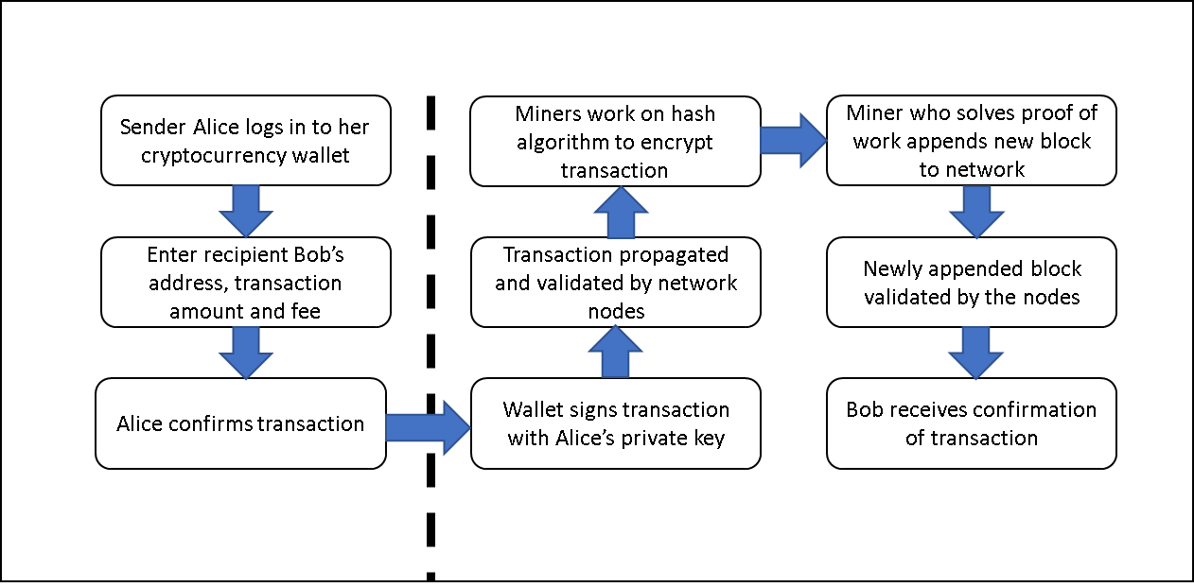


Blockchain Transaction Cycle
Alice
Bob

Slide 10
Trust & Security in Blockchain
All the transactions are visible in their entirety to every party
Complete transactional history can be verified by anybody in the network
Identity of account holder is masked by hash value of user's private key
Transparency but Anonymity
Transactions are immutable or irreversible
Attempt to alteration of records rejected due to mismatch of cryptographic hashes
Immutability
Trust between parties established based on a secure environment
Private-public key mechanism authenticates and protects every transaction
Decentralized architecture significantly reduces probability of any successful attack
Enhanced Security

Slide 11

Trustworthy but Vulnerable!
Allinvain Theft
Mt. Gox Hack
MyBitcoin Theft
Bitcoin Heists
Ubitex Scam
Bitscalper Scam
Andrew Nollan Scam
Stoneman Loss

Slide 12


Why Hack/Theft Happens?
Lack of Regulations:
No structured regulation and reporting process in support of Anti-Money Laundering (AML) and Enterprise Fraud Management (EFM) in place
Anonymity in Blockchain:
Offenders are encouraged with the fact that their identity would not be compromised due to the anonymous nature of blockchain transactors

Slide 13
Objective
Develop a trust mechanism in the form of a risk score for all users operating in a blockchain network which enables users to avoid risky parties to deal with while making transactions in the cryptocurrency marketplace.

Slide 14
Enhancing Trust
Conventional Currency Transaction:
Trust ensured by external third parties or other regulatory authorities
Cryptocurrency Transaction:
Users empowered with self-guided trust enhanced by user risk scores

Slide 15
Our Approach
Create a list of transaction ID’s associated with known scams
Assign a risk factor to all observed transactions
Check accuracy measures for the developed models
Create Blacklist
Sample Transactions
Identify Risk
Profile Transactions
Validate Models
Build Risk Scores
Pull transactions from and outside the blacklist
Use machine learning algorithms to train a model to observed data
Generate risk scores for all transactions based on the fitted model

Slide 16
The Blacklist
List of known hacks and thefts
Addresses and transaction ID’s that are associated with known hacks or thefts are placed on this blacklist
Profiling such behavior allows us to find future transactions with similar behavior

Slide 17
Bitcoin Database
Block- and transaction-level details for every bitcoin transaction until February 9, 2018
Over 300 million bitcoin transactions in more than 500,000 blocks

Slide 18
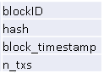
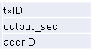
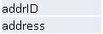
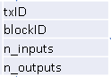
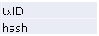
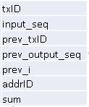
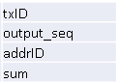
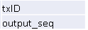
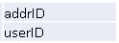
Database Schema
Table: bh
Table: multiple
blockID
Table: addresses
Table: tx
txID
Table: txh
txID
txID
addrID
Table: txin
Table: nonstandard
Table: txout
Table: addr_sccs
txID
txID
addrID

Slide 19
Data for Modeling
A sampled set of transactions are considered for analysis
A risk factor (0 or 1) has been added to this dataset
This results in a dataset with:
8,109 total data points
2,172 transactions with risk level 1(hack)
5,937 transactions with risk level 0 (non-hack)

Slide 20
Modeling Approaches
Perform three different classification methods:
Random Forest
K-Nearest Neighbor
Support Vector Machine
Split using Stratified ShuffleSplit cross-validation from Python's scikit-learn:
10 folds
80% training
20% testing
Returns stratified randomized folds
Folds are made by preserving the percentage of samples for each class
Run baseline models with all variables
Perform feature engineering to fine-tune models

Slide 21
Machine Learning: Random Forest
Random Forest is an ensemble method for classification or regression
Uses multiple fully grown decision tress for training
Results obtained by modal value of categories obtained by individual trees
X1 <= 5
X1 > 5
X1 <= 5
X1 > 5
X2 >= 0
X1 < 0
Win
Loss
Win
Loss
Win
Loss
X2 >= 0
X2 < 0
X3 = H
X3 = A
X3 = H
X3 = A
Win
Loss
Win
Win
Win
Loss
Tree 1
Tree 2
Tree 3
New Observation:
X1 = 3, X2 = 1,
X3 = A
Tree 1: Win
Tree 2: Win
Tree 3: Loss
RF result: Win

Slide 22
Random Forest Results
Model built based on top 7 features:
Number of transactions per block
Number of inputs
Number of outputs
Input sum
Output sum
Input sequence
Output sequence
 | Predicted: 0 | Predicted: 1
Actual: 0 | 1190 | 3
Actual: 1 | 0 | 429
 | Precision | Recall | F1-Score | Support
0 | 1.00 | 1.00 | 1.00 | 1,193
1 | 0.99 | 1.00 | 0.89 | 429
Average | 1.00 | 1.00 | 1.00 | 1,622
Accuracy | 99.81%

Slide 23
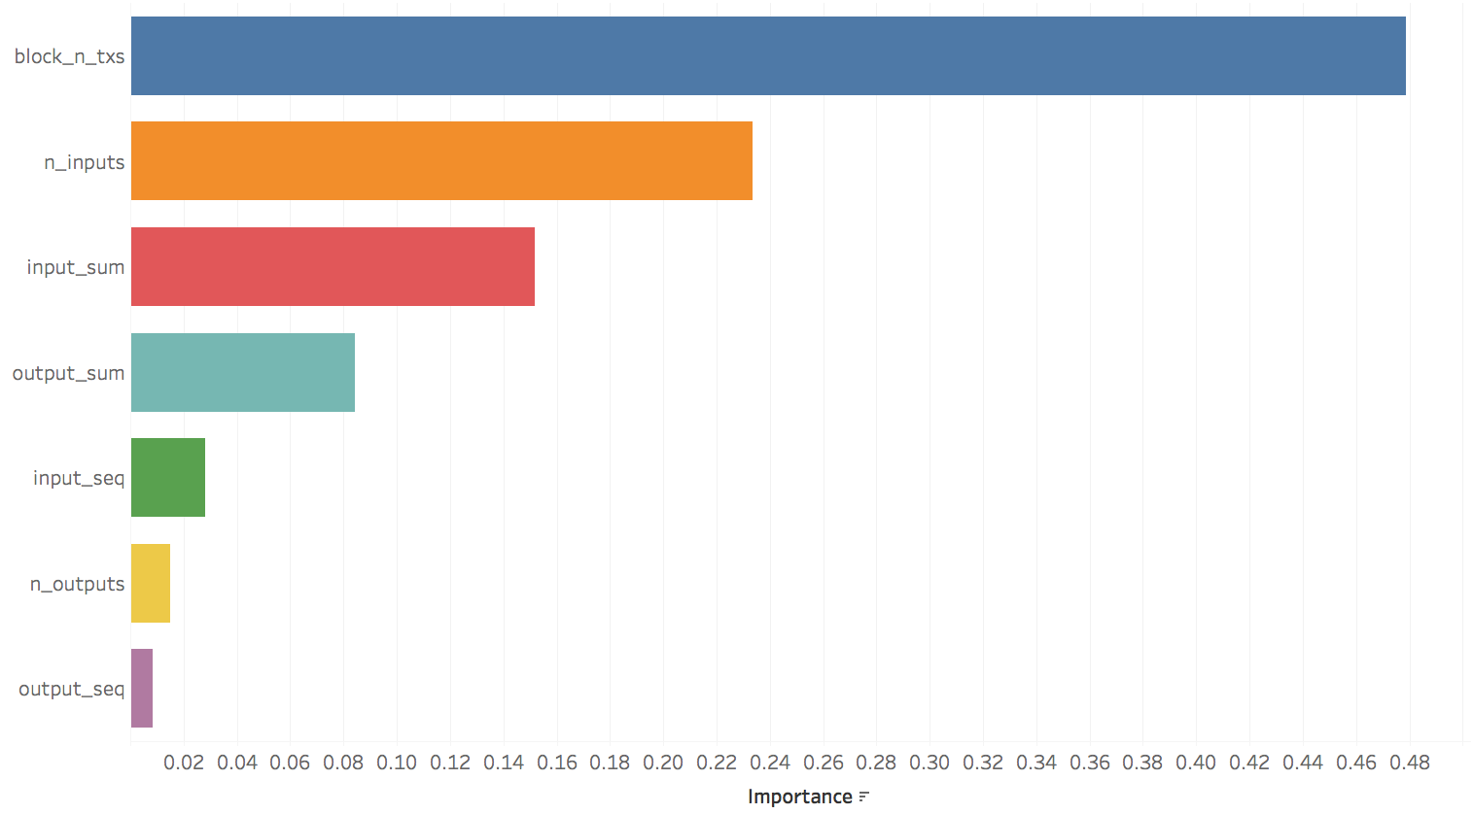
Random Forest: Feature Importance

Slide 24
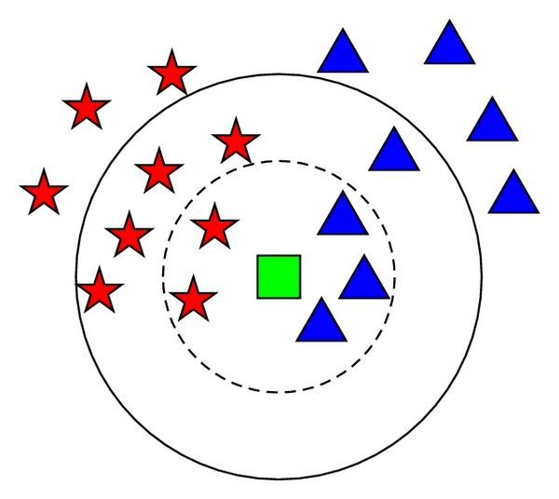
Machine Learning: K-Nearest Neighbors
Non-parametric method for classification or regression
In classification, the unknown is classified as the majority class of the neighbors
Result of the unknown observation is determined by the average value of the K nearest neighbors of the unknown
Known classes: Red star & Blue triangle
Unknown member: Green Square
If K = 5,
Unknown is classified as Blue triangle
If K = 9,
Unknown is classified as Red star

Slide 25
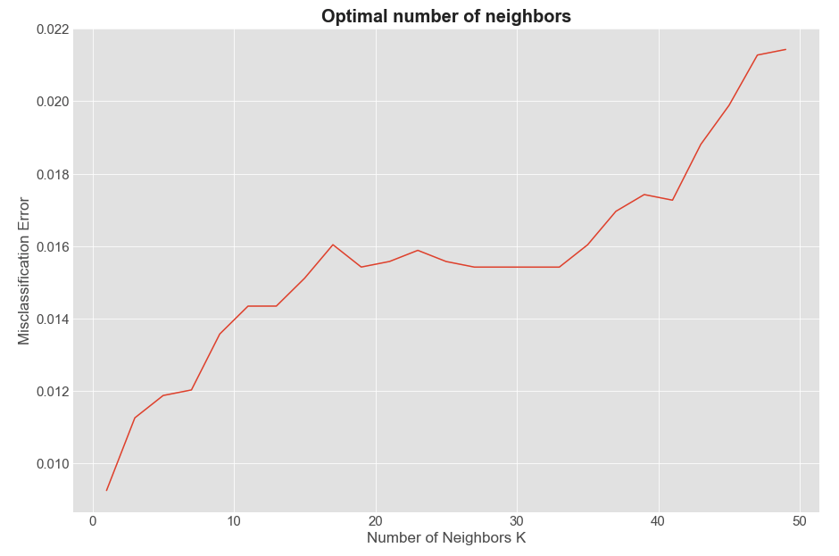
KNN Results
Run with top 2 features:
Number of transactions per block
Number of inputs
Iterate through range of K
K = 1-50
Find optimal number of neighbors
Train model with optimal number of neighbors
 | Precision | Recall | F1-Score | Support
0 | 1.00 | 1.00 | 1.00 | 1,193
1 | 0.99 | 1.00 | 0.99 | 429
Average | 1.00 | 1.00 | 1.00 | 1,622
Accuracy | 99.88%
 | Predicted: 0 | Predicted: 1
Actual: 0 | 1,190 | 2
Actual: 1 | 0 | 427

Slide 26
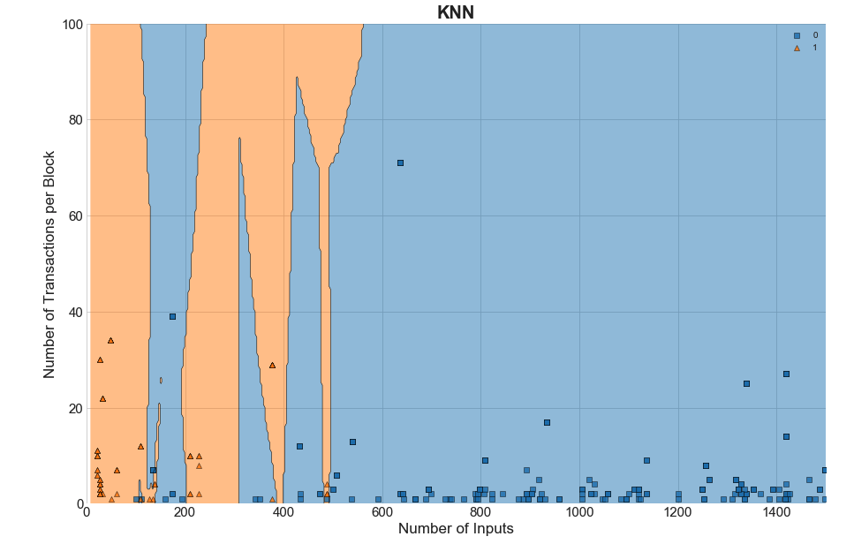

KNN Visualization
Hacks =
Non-Hacks =

Slide 27
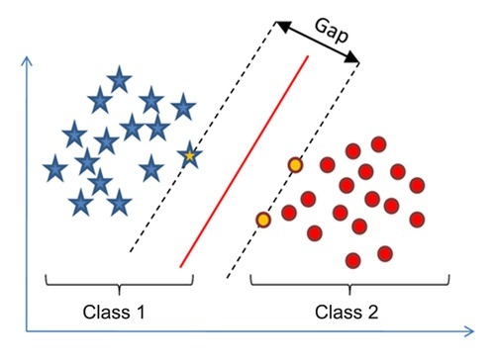
Machine Learning: Support-Vector Machine
Support-Vector Machine (SVM) creates a hyperplane or set of hyperplanes for classification
In a 2-dimensional space, hyperplane becomes a straight or curved line
Line with maximum margin forms support vector

Slide 28
SVM Results
Developed SVM model with top 2 features:
Number of transactions per block
Number of inputs
 | Precision | Recall | F1-Score | Support
0 | 1.00 | 0.84 | 0.91 | 1,188
1 | 0.70 | 1.00 | 0.82 | 434
Average | 0.92 | 0.88 | 0.89 | 1,622
Average Accuracy | 85.96%
 | Predicted: 0 | Predicted: 1
Actual: 0 | 999 | 189
Actual: 1 | 0 | 434

Slide 29
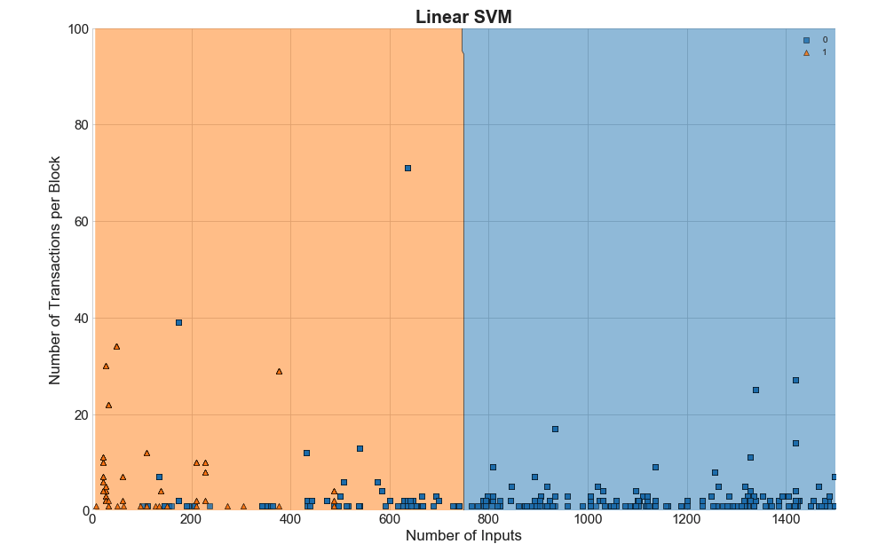

SVM Visualization
Hacks =
Non-Hacks =

Slide 30
Risk Scoring Method
Risk score assigned against every unique address ID
Indicates trustworthiness for a user
Score measured on a scale of 0 to 1
Risk Score = (Total number of high risk transactions) /
(Total number of transactions performed by an address ID)

Slide 31

Risk Scoring Examples
# of transactions = 115
# of transactions = 81
# of transactions = 203
# of transactions classified as risky = 4
# of transactions classified as risky = 15
# of transactions classified as risky = 97
Bob
Alice
Trudy
Risk Score = 0.0347
Risk Score = 0.185
Risk Score = 0.4778
Risk Score = (Total number of high risk transactions) /
(Total number of transactions by an address ID)

Slide 32
Conclusions
Random Forest and KNN models are overfitted
SVM model correctly classifies 86% of transactions based on two features:
Number of transactions per block
Number of inputs per transaction
SVM classifies all hacking incidents correctly
While SVM’s training time is longer, for a risk scoring application, that is a good tradeoff
 | Accuracy
Random Forest | 99.81%
KNN | 99.96%
SVM | 85.96%
 | Actual: 0 | Actual: 1
Predicted: 0 | 999 | 0
Predicted: 1 | 189 | 434

Slide 33
Future Work
Scale up our modeling to entire historical Bitcoin dataset with aid of more powerful computing infrastructure
Address profile can be created with the following:
Pooled transaction
Exchange transaction
Mining transaction
Develop a reputation score for each address by augmenting the risk score with the profile of transactions

